Slide 1
Architecting on AWS (3 DAYS)
Mayank Pandey

Slide 2
Summary of the course
This course covers the fundamentals of building IT infrastructure on the AWS platform. Students learn how to optimize the AWS Cloud by understanding how AWS services fit into cloud-based solutions. In addition, students explore AWS Cloud best practices and design patterns for architecting optimal IT solutions on AWS and build a variety of infrastructures in guided, hands-on activities. The course also covers how to create fledgling architectures and build them into robust and adaptive solutions.

Slide 3
Objectives
Make architectural decisions based on AWS architectural principles and best practices
Leverage AWS services to make your infrastructure scalable, reliable, and highly available
Leverage AWS Managed Services to enable greater flexibility and resiliency in an infrastructure
Make an AWS-based infrastructure more efficient to increase performance and reduce costs
Use the Well-Architected Framework to improve architectures with AWS solutions
Understand and navigate the core networking services including VPCs, subnets, etc.
Understand and implement security best practices
Understand and use the core compute services including EC2, storage, AMIs, load balancers, etc.
Use monitoring, logging, and alerting services with CloudWatch
Build repeatable disposable infrastructure with Terraform
Understand and use a variety of fully managed services including RDS, DynamoDB, Lambda, API Gateway, Simple Notification Service, Simple Queue Service, ElastiCache, Systems Manager, etc.

Slide 4
Activities in this course
INDIVIDUAL LABS
Create an EC2 instance from a custom AMI.
Create a VPC with Public & Private Subnets, Route Tables, Gateways, public & private EC2 instances.
Create a multi-AZ RDS in your VPCs private subnets and access it from a public EC2 instance.
Explore S3 CLI commands and host a static website out of S3.
Create an auto-scaling environment and access an application behind a Load Balancer.
Creation of AWS resources using Terraform.
GROUP ACTIVITIES
Design a lift shift architecture on AWS.
Design a scalable, reliable, secure, cost optimized AWS architecture for a public web app.
DEMONSTRATIONS
Creation of IAM user & role with custom policies.
AWS Organizations & SCP.
Security Group & NACL custom rules setup.
S3 – features & usage
Lambda usage for automation in AWS account.

Slide 5





Optimize your learning
Use your breaks.
Have fun.
Participate.
Ask questions.
Do the labs.

Slide 6
AWS Architect responsibilities
Plan
Set technical cloud strategy with business leads
Analyze solutions for business needs and requirements
Research
Investigate cloud services specifications and workload requirements
Review existing workload architectures
Design prototype solutions
Build
Design the transformation roadmap with milestones, work streams, and owners
Manage the adoption and migration

Slide 7
What is Cloud Native?
Cloud-native refers to the way an application is built and deployed, specifically leveraging the benefits of the cloud. It implies that the apps exist in the public cloud, rather than within an on-premises datacenter.
Traditional development focuses on the application first and where the infrastructure is hosted as second. Cloud native development is as much a philosophy as it is a set of tools. It’s the notion that we consider all factors from day one. Through cloud native development we consider where the application is hosted and what sort of services or technologies can be leveraged from that platform (e.g. AWS).

Slide 8
Benefits
Cloud native architectures take full advantage of on-demand delivery, global deployment, elasticity, and higher-level services.
They enable huge improvements in –
developer productivity,
business agility,
scalability,
availability,
utilization,
cost savings.

Slide 9
What about Infrastructure?

Slide 10
Problems with traditional IT approach

Slide 11
Problems with traditional IT approach
Pay for the rent for the data center
Pay for power supply, cooling, maintenance
Adding and replacing hardware takes time
Scaling is limited
Hire 24/7 team to monitor the infrastructure
How to deal with disasters? (earthquake, power shutdown, fire…)

Slide 12
Benefits of Public Cloud

Slide 13
Benefits of Public Cloud
On-demand self service:
Users can provision resources and use them without human interaction from the service provider
Broad network access:
Resources available over the network, and can be accessed by diverse client platforms
Multi-tenancy and resource pooling:
Multiple customers can share the same infrastructure and applications with security and privacy
Multiple customers are serviced from the same physical resources
Rapid elasticity and scalability:
Automatically and quickly acquire and dispose resources when needed
Quickly and easily scale based on demand
Measured service:
Usage is measured, users pay correctly for what they have used
Amazon Web Services (AWS) owns and maintains the network-connected hardware required for these application services, while you provision and use what you need.

Slide 14
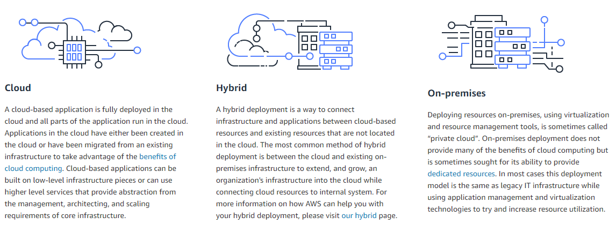
Cloud Computing Deployment Models

Slide 15
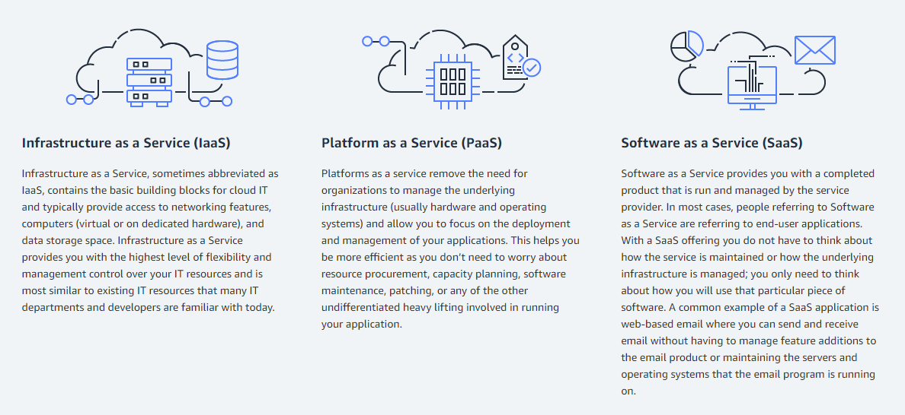
Cloud Computing Models

Slide 16
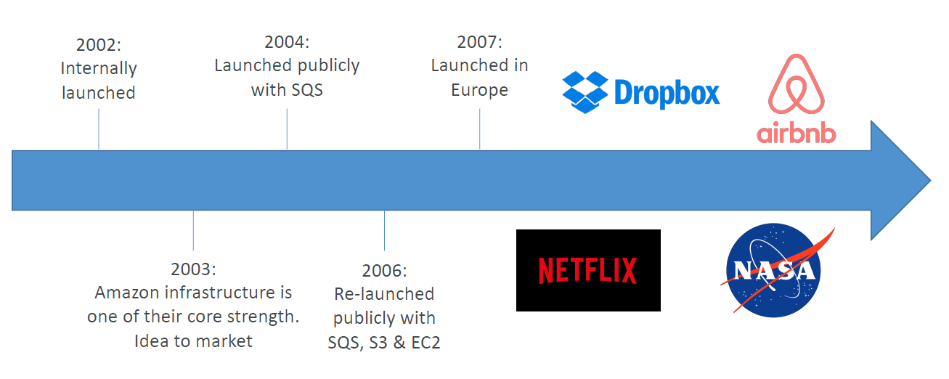
AWS Cloud History

Slide 17
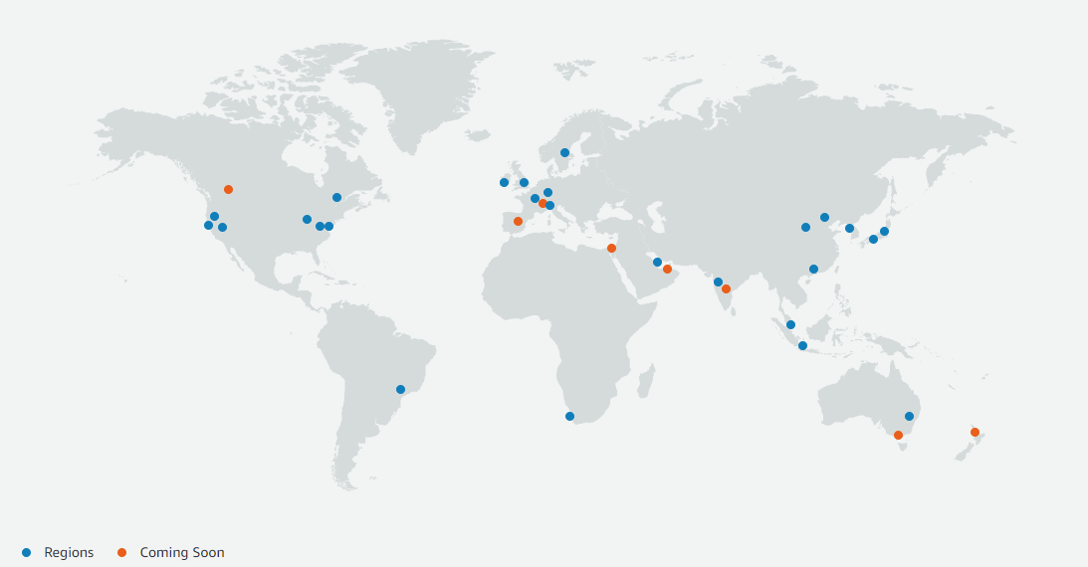
AWS Global Infrastructure Map

Slide 18
Regions & Availability Zones

Slide 19
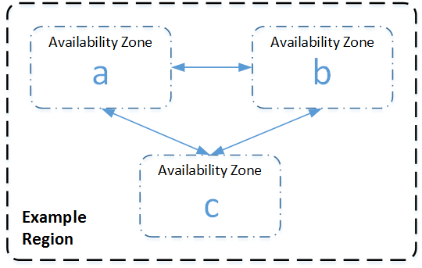
Regions & Availability Zones
Regions
Geographic locations (around the world)
Consists of at least 3 Availability Zones
Availability Zones
Clusters of data centers
Isolated in their supplies from other AZ
Isolated from failures in other Availability Zones
AZs with in a region are connected via private network
Region:
us-east-1
Availability Zone:
us-east-1a
us-east-1b
us-east-1c

Slide 20
Accessing AWS
AWS Management Console
GUI method via browser
Username & password
AWS CLI
Install easily on your laptop / (or use AWS CloudShell)
Access Key ID & Secret Access Key
AWS SDK
Many programming languages are supported
Access Key ID & Secret Access Key

Slide 21
Scope of an AWS Service/Resource
Global
Route53, IAM, CloudFront
Regional
VPC, EFS, Load Balancer, DynamoDB, S3
AZ based
Subnet, EC2, EBS, NAT Gateway, ENI

Slide 22
Data Transfer Considerations
Data IN to AWS is FREE.
Data OUT of AWS is charged.
The complexity of Pricing on Cloud depends on the type of service under consideration.
You need to understand all the factors around the pricing of a particular service.
Unmanaged
Services
Managed
Complex
Pricing
Simple

Slide 23
Ensuring HA for an application

Slide 24
Ensuring HA for an application
Any infrastructure component must be located in at least 2 AZs
Few AWS services do this automatically, for others you need to architect it
For even higher Service Availability, deploy in 2 regions (2 AZs in each region)

Slide 25
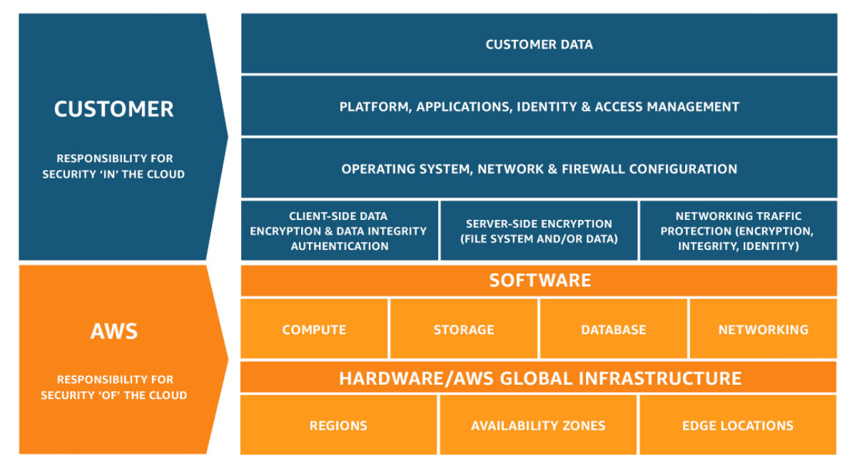
Shared Responsibility Model

Slide 26




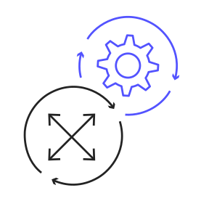
AWS Well-Architected Framework
The AWS Well-Architected Tool (AWS WA Tool) helps cloud architects learn, measure, and build using architectural best practices.
Security
Cost optimization
Reliability
Performance
efficiency
Operational excellence

Slide 27





Well-Architected Framework Pillars
Security
Cost optimization
Reliability
Performance
efficiency
Operational excellence
Apply at all layers
Principle of least privilege
Multi-factor authentication (MFA)
Analyze and attribute expenditures
Cost-effective resources
Stop guessing
Recover from failure
Test recovery procedures
Scale to increase availability
Reduce latency
Use serverless architecture
Incorporate monitoring
Perform operations with code
Test response for unexpected events
There is a new pillar added recently - SUSTAINABILITY
AWS gives a useful WA Tool

Slide 28

Questions / Quiz Time

Slide 29
IDENTITY & ACCESS MANAGEMENT

Slide 30
How many AWS accounts does a customer need?

Slide 31
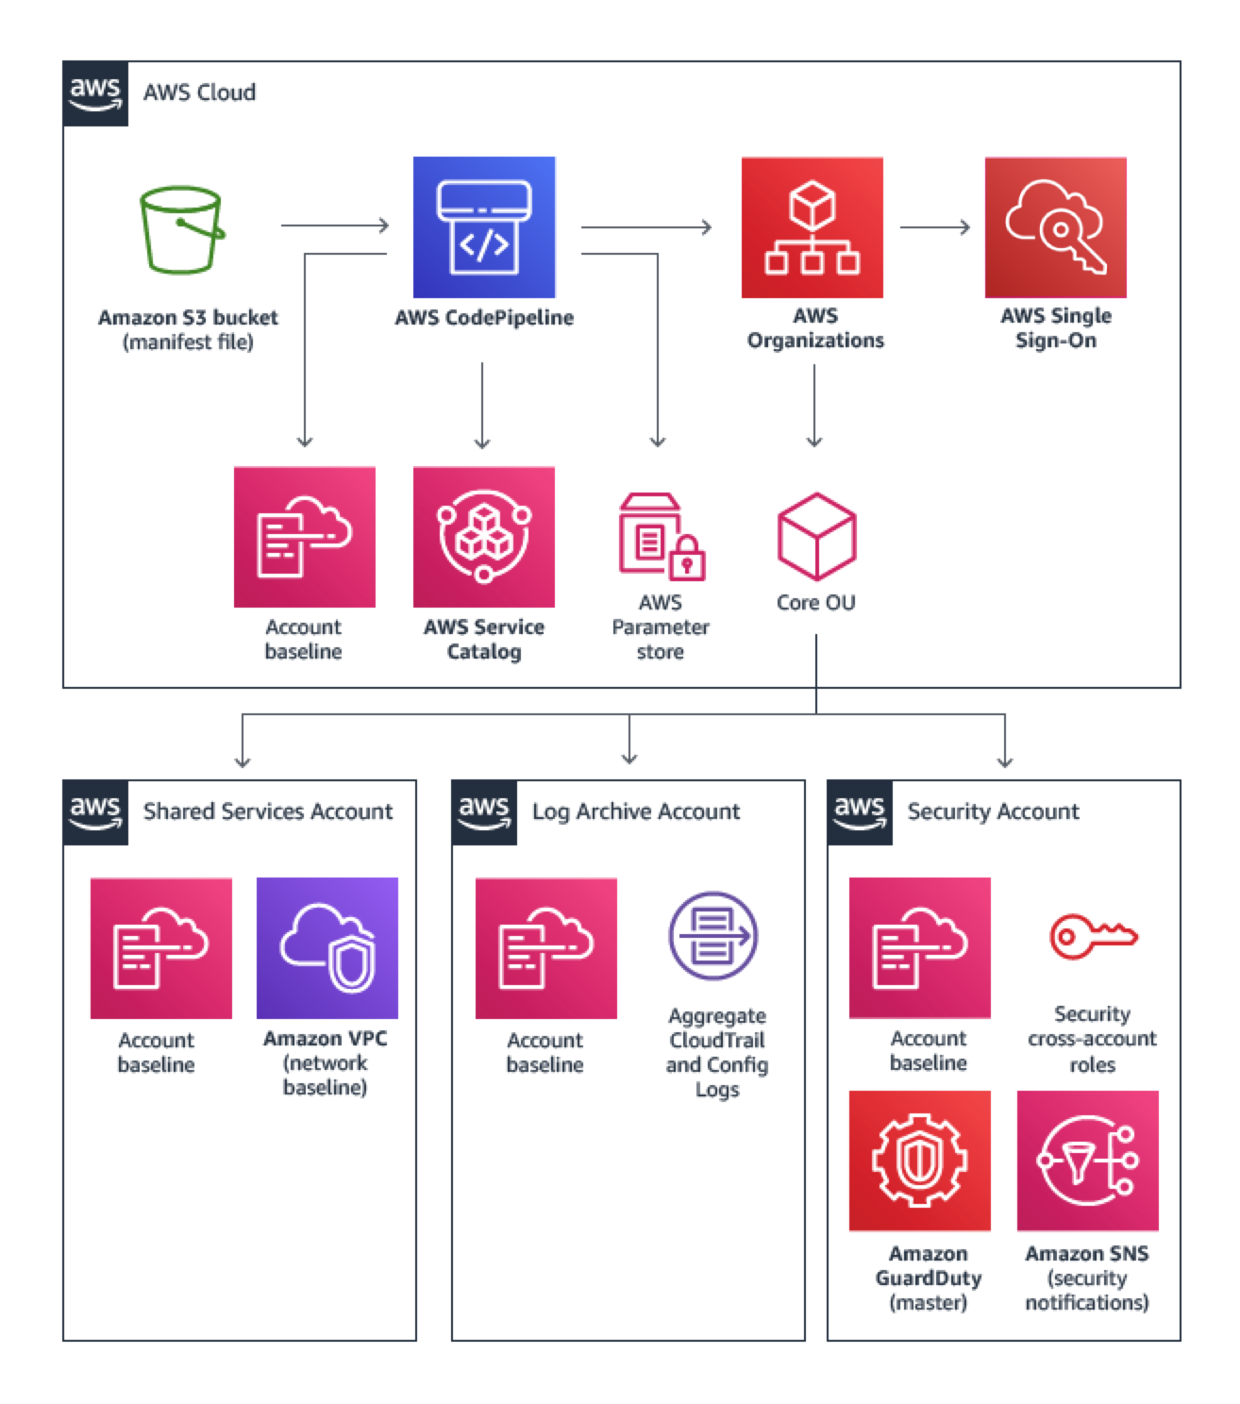
How many AWS accounts does a customer need?
Typically more than one account is always required.
First account is the Master Account (or Management Account). Bills of all the accounts get consolidated here. You get tiered discount as well.
Other accounts (as per the best practices):
Log Archive Account
Security Account
Shared Services Account
Other accounts based on Business Unit, Workload, etc.

Slide 32
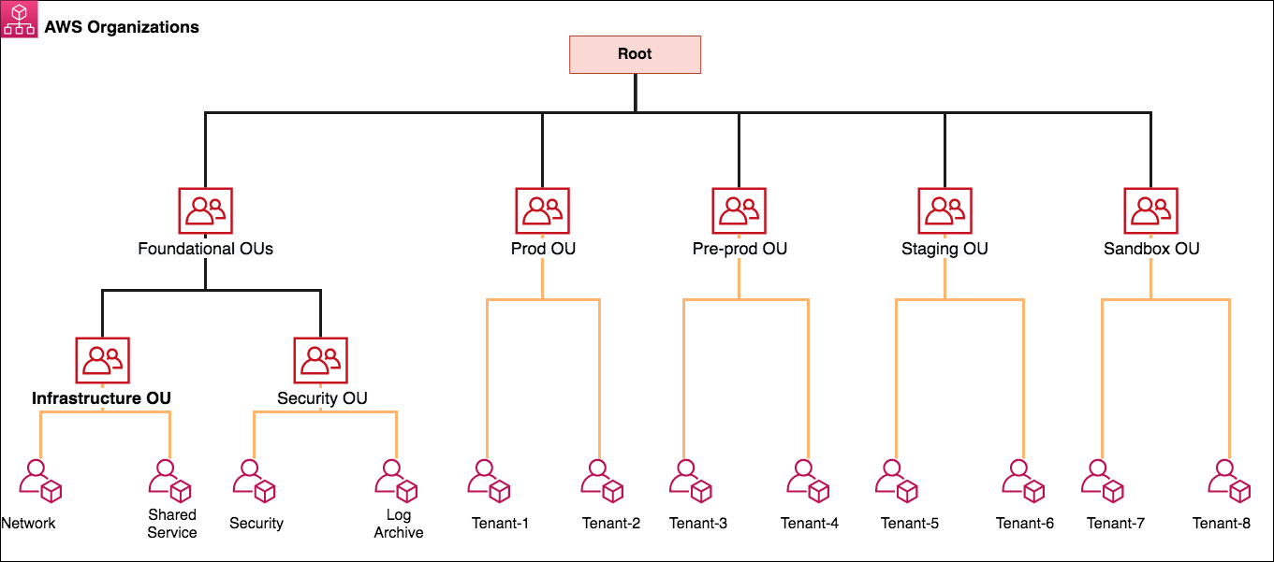
Managing multiple accounts - AWS Organizations
SCPs (Service Control Policy) can be applied at any node.
Master/Management Account remains unaffected by SCPs.

Slide 33
New AWS Account
New AWS account creation process:
Independent account creation
Under AWS Organizations
Free Tier usage & benefits
Why are Limits/Quota important?

Slide 34
IAM - Users & Groups
Root user gets created by default. It shouldn’t be used or shared (E.g. bu01@abc.com)
Identity and Access Management (IAM) is a global service
IAM Users are people within your organization, and can be grouped
IAM Groups only contain users, not other groups
Users may (or may not) belong to a group
A user can belong to multiple groups

Slide 35
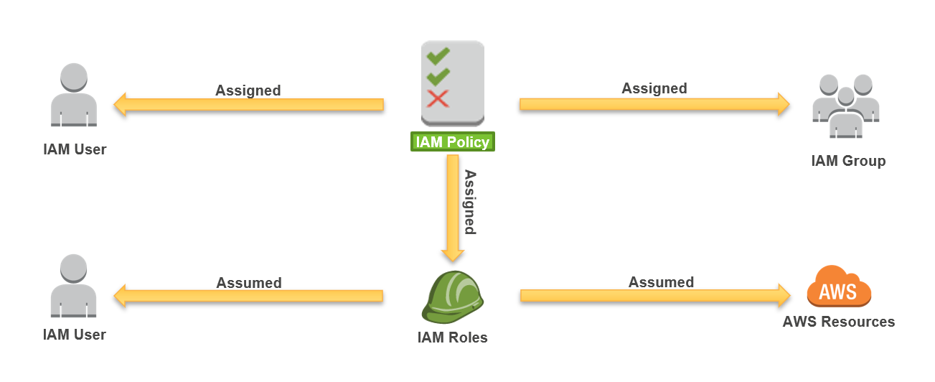
IAM Policies
There are following types of policies:
Managed Policies – these can be attached to multiple IAM entities.
Amazon Managed Policies
Customer Managed Policies
Inline Policies – these are written specific to a particular IAM entity.
Resource based policies
When two conflicting permissions come together,
DENY always WINS.

Slide 36
Policy Elements
 | Description | Required
Effect | Use Allow or Deny to indicate whether the policy allows or denies access. | ✔
Principal | Indicate the account, user, role, or federated user to which you want to allow or deny access (only on resource policies).
Action | Include a list of actions that the policy allows or denies. | ✔
Resource | Specify a list of resources to which the actions apply. | ✔
Condition | Specify the circumstances under which the policy grants permission.

Slide 37
IAM - Roles
Role is an IAM identity that you can create in your account and has specific permissions. An IAM role has some similarities to an IAM user. Roles and users are both AWS identities with permissions policies that determine what the identity can and cannot do in AWS. However, instead of being uniquely associated with one person, a role is intended to be assumable by anyone who needs it. Also, a role does not have standard long-term credentials such as a password or access keys associated with it. Instead, when you assume a role, it provides you with temporary security credentials for your role session.
Roles can be used by the following:
People: Grant cross-account access to employees.
Applications: Permit applications running on AWS or on premises to make AWS API calls.
AWS Services: Permit AWS services to make AWS API calls on your behalf.
Examples: EC2 Instance Roles, Roles for Lambda Function, Roles for CloudFormation

Slide 38
IAM Best Practices
Never use Root User’s access keys.
Create individual IAM users.
Use groups to assign permissions to IAM users.
Grant least privilege always.
Configure a strong password policy.
Enable MFA for all the IAM users.
Use roles for applications that run on Amazon EC2 instances.
Delegate by using roles instead of by sharing credentials.
Rotate credentials regularly.
Remove unnecessary/inactive users and credentials.
Use IAM policy conditions for extra security.

Slide 39
AWS Account for the Labs
Please create only those resources as instructed during the course.
Kindly delete all the resources after a lab gets completed (or when instructed).
Please do not abuse this AWS environment by creating any additional resources.
Open the given URL and bookmark it in your browser for this training.
Use the credentials & AWS account allocated to you.
Feel free to ask me doubts while doing the labs. But, you should put your best efforts to explore as well.
Login and change your password for further use. Please make a note of your password carefully!

Slide 40
Demo
Create an IAM role “myEC2Role”:
Allow this role to be assumed by EC2 service.
It should allow upload & download to S3 buckets having names starting with “ntt”.
Create an IAM user “Steve” who could do following:
View all resources in the account, except the details of EBS volumes.
Do all the EC2 actions; but, could not terminate the EC2 instance with tag “Key: Environment”, “Value: Production”

Slide 41
Questions / Quiz Time

Slide 42
How do you choose a region?
Does the region meet your environment’s data sovereignty and compliance requirements?
How close is the region to your users or data centers?
Does the region you’re considering offer all of the services and features your environment might require?
Are you choosing the most cost-effective region?

Slide 43




How Many Availability Zones Should I Use?
Recommendation: Start with two Availability Zones per region.
Best practice: If resources in one Availability Zone are unreachable, your application shouldn't fail.
Most applications can support two Availability Zones.
Using more than two Availability Zones for HA (with in a region) is not usually cost-effective.
Internet gateway
Elastic load balancer
Public Subnet 1
Web server
Web server
Public Subnet 2
Availability Zone 1
Availability Zone 2
AWS Region

Slide 44
ELASTIC COMPUTE CLOUD (EC2)

Slide 45
EC2 Basics
Operating System (OS): RHEL, SLES, Ubuntu, Amazon Linux, Windows or Mac OS
How much compute power & cores (CPU)
How much random-access memory (RAM)
How much storage space:
Network-attached (EBS)
Host (Instance Store)
Network card: speed of the card, Public IP address
Firewall rules: security group
Bootstrap script (runs once during the launch): EC2 User Data

Slide 46


EC2 Architecture
Virtual Machines (Amazon EC2 instances)
Hypervisor
Amazon EC2
CPUs
Network
Amazon S3
RAM
Instance Store (Ephemeral)
EBS-Optimized
Amazon EBS

Slide 47
Amazon Machine Image (AMI)
An AMI includes the following:
One or more Amazon Elastic Block Store (Amazon EBS) snapshots.
Launch permissions that control which AWS accounts can use the AMI to launch instances.
A block device mapping that specifies the volumes to attach to the instance when it's launched.
When you create an AMI, it captures all the content which is there at the disk level
A custom AMI gives faster boot / configuration time because all your software is pre-packaged
AMI is a regional resource. It can be copied across regions
You can launch EC2 instances from:
A Public AMI: AWS provided
Your own AMI: you customize and maintain them yourself
An AWS Marketplace AMI: an AMI sold or provided by a 3rd party software vendor

Slide 48



Launching instances from an AMI
Amazon EC2 service
EC2 instance
Launch
AMI
EC2 instance
EC2 instance

Slide 49





Custom AMI creation (Golden AMI approach)
EC2 instance contents
Install and
configure
Create AMI
Create
instances
Internal tools, security packages, and configuration
Running instance
New AMI
New instances
Run commands at launch
Instance user data

Slide 50

EC2 Lifecycle
Launch
pending
Start
AMI
rebooting
Reboot
running
Stop
stopping
stopped
Terminate
shutting-down
terminated
Terminate

Slide 51
Reboot vs. Stop vs. Terminate
Characteristic | Reboot | Stop/Start | Terminate
Host computer | The instance stays on the same host computer. | The instance runs on a new host computer.
Public IP address | No change | New address assigned
Elastic IP addresses (EIP) | EIP remains associated with the instance. | EIP remains associated with the instance. | EIP is disassociated from the instance.
Instance store volumes | Preserved | Erased | Erased
EBS volume | Preserved | Preserved | Boot volume is deleted by default.
Billing | Instance billing hour doesn’t change. | You stop incurring charges as soon as state is changed to stopping. | You stop incurring charges as soon as state is changed to shutting-down.

Slide 52
Instance metadata & user data
Metadata
Data about the EC2 instance can be used for automation
Access it via URL (from the instance) - http://169.254.169.254/latest/meta-data/
User data
Runs scripts as root after the instance starts
Can be passed to the instance at launch
Can be used to perform common automated configuration tasks
Access it via URL (from the instance) - http://169.254.169.254/latest/user-data/

Slide 53
EC2 Purchase Options
On-Demand | Reserved | Spot Instances
No commitment Pay by the hour Any partial hour converted to full A new billing cycle starts whenever an instance changes to “Running” state A billing cycle ends when instance changes to “Stopping” state Billing cycles don’t start at 9am, 10 am etc. Pay per second (supported for few Operating Systems) | Two terms available – 1 year or 3 years 3 Payment options: Full Upfront Partial Upfront No Upfront (not for 3 years term) Lot of saving in comparison to On-Demand Gives you Capacity Guarantee as well You commit the usage for chosen term You can re-sell on AWS if you choose not to use Considered for full term (or production usage) | Unused capacity at AWS is given in market for bidding Look at pricing history and decide the maximum price Instances are terminated with 2 minutes notice when market price goes above bid price If terminated by AWS, last partial hour is free Optionally, use Spot Block option with bid to block the instance (maximum 6 hours) Suitable for resumable applications, back end processing

Slide 54
EBS Types
SSD
General Purpose SSD (gp2 & gp3) – consistent IOPS, cheaper
Provisioned IOPS SSD (io1 & io2) – higher IOPS and costlier
HDD
Throughput Optimized HDD (Higher throughput)
Cold HDD (lower throughput, cheaper)
These cannot act as the boot disk (OS volume)

Slide 55
EBS Snapshots
Make a backup (snapshot) of your EBS volume at a point in time
Not necessary to detach volume to do snapshot, but recommended
A regional resource and stored in Amazon managed S3
Can copy snapshots across regions
Volume2
Volume1
backup
Snapshot
create new
create new
Volume3

Slide 56
Lab 1
Time allocated: 20 mins
Launch an EC2 instance (Amazon Linux, t2.micro). Connect to it via EC2-connect option from your browser. Install Apache web server on it. Access this public website from a browser. You may use your mobile to access it as well.
Stop this EC2 instance and then create an AMI of it. Launch another instance from the AMI and check if all your changes persist? (i.e. webserver installation).
After completing this, terminate all the EC2 instances. Also, deregister all the AMIs and delete the snapshots & volumes from your account.

Slide 57
Questions / Quiz Time

Slide 58
VIRTUAL PRIVATE CLOUD (VPC)

Slide 59

Public and private IP addresses
Public IP Address
Private IP Address
Public IP: 54.56.9.10
Private IP: 172.31.1.90
Public IP addresses are IPv4 addresses reachable from the internet.
Private IP addresses are not reachable from the internet.

Slide 60
Amazon Virtual Private Cloud (VPC)
Virtual network; isolated portion of AWS cloud that you design
Optional dedicated tenancy
Supports logical separation with subnets
Fine-grained security
Private address ranges specified using Classless Inter-Domain Routing (CIDR) notation
AWS VPCs can use CIDR ranges between /16 and /28.
For every one step a CIDR range increases, the total number of IPs is cut in half:
CIDR / Total IPs
/16 65,536 | /17 32,768 | /18 16,384 | /19 8,192 | /20 4,096 | /21 2,048 | /22 1,024
/23 512 | /24 256 | /25 128 | /26 64 | /27 32 | /28 16

Slide 61


VPC
VPCs can span across multiple Availability Zones within a region.
VPCs have an implicit router and a default route table that routes local traffic within the VPC.
VPCs are private networks until associated with an Internet gateway and a route table rule routing traffic through it.
Default Amazon VPCs are provisioned at account creation in every region. Do not use this for your customer workloads.
Region
Default route (Can’t change)
Destination | Target
172.31.0.0/16 | local
VPC
Availability Zone 1
Availability Zone 2

Slide 62


Subnets
Subnets segment VPC address ranges even further.
Subnets can exist within one and only one Availability Zone.
Subnet CIDR blocks within a VPC must not overlap.
Subnet inbound and outbound traffic can be restricted using NACLs.
Recommendation: Allocate substantially more IPs for private subnets than for public subnets.
Region
VPC
Availability Zone 1
Public subnet
Private subnet
Availability Zone 2
Public subnet
Private subnet

Slide 63
Other VPC concepts
Internet gateways permit communication between instances in your VPC and the internet.
They are horizontally scaled, redundant, and highly available by default.
They provide a target in your subnet route tables for internet-routable traffic.
Public subnets allow external communication through public IP addresses.
There is no automatic outbound routing. You access the internet by way of the internet gateway.
NAT Gateway helps instances in the private subnet to access internet.
Traffic in the VPC stays local.

Slide 64




Elastic Network Interface
An elastic network interface is a virtual network interface that:
Can be moved across EC2 instances in the same Availability Zone
Maintains its private IP address, Elastic IP address, and MAC address
VPC
Availability Zone
Public subnet
Security group
Customer
Elastic IP
Internet gateway
Elastic network interface (Network interface)
Instance
Private IPv4: 10.0.1.110

Slide 65
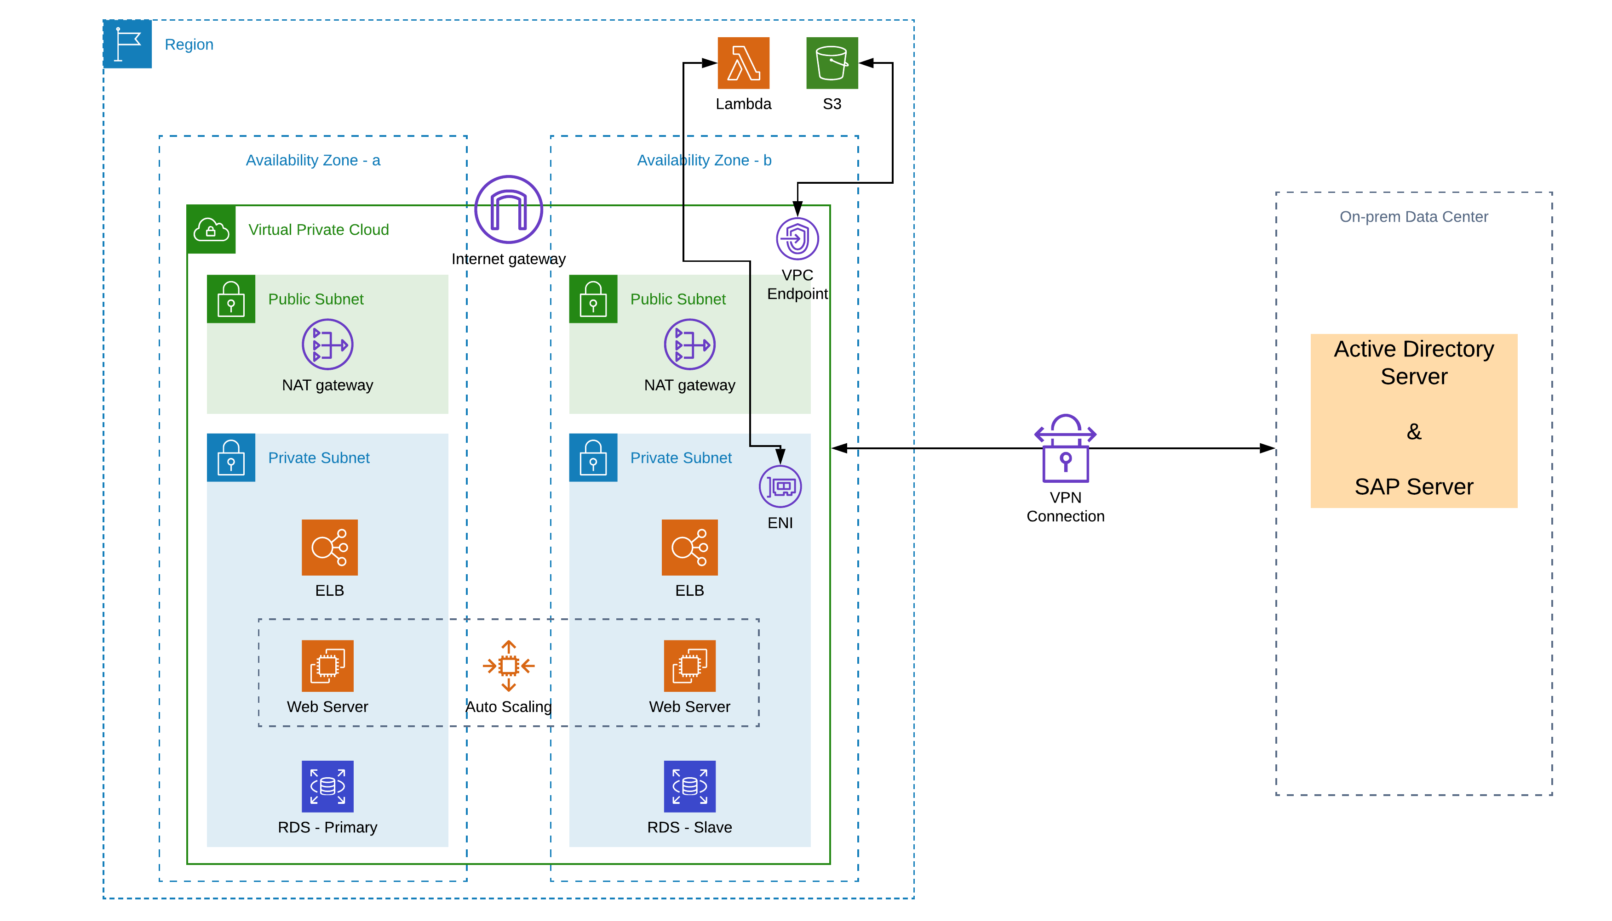
VPC in action – A Production Setup

Slide 66
Security Groups vs NACL
Security Group | Network ACL
Associated to an elastic network interface and implemented in the hypervisor (instance level) | Associated to a subnet and implemented in the network
Supports Allow rules only | Supports Allow rules and Deny rules
A stateful firewall | A stateless firewall
All rules are evaluated before deciding whether to allow traffic | All rules are processed in order when deciding whether to allow traffic
Needs to be manually assigned to instances | Automatically applied when instances are added to subnet
Requires configuration to allow communication | Allows communication by default

Slide 67
VPC Endpoints
VPC Endpoints allow connectivity to AWS services in a private manner via Amazon’s network (without going via internet).
There are 2 types of VPC endpoints:
1. Gateway Endpoint – works for S3, DynamoDB.
2. Interface Endpoint – works for CloudWatch, Systems Manager, SQS, SNS, and many other services.

Slide 68

Security Group Chaining
Web tier ELB
security group
Inbound Rule
Allow TCP Port 443
Source: 0.0.0.0/0 (Any)
Web tier
security group
Inbound Rule
Allow TCP Port 80
Source: Web tier ELB
web
web
Inbound Rule
Allow TCP Port 8080
Source: Web tier
App tier ELB
security group
App tier
security group
Inbound Rule
Allow TCP Port 8080
Source: App tier ELB
app
app
data
Data tier
security group
data
Inbound Rule
Allow TCP Port 3306
Source: App tier
Availability Zone A
Availability Zone B

Slide 69
Questions / Quiz Time

Slide 70
Lab 2
Time allocated: 45 mins
Create a new VPC with CIDR 10.0.0.0/26
Divide this into 4 subnets of equal size across 2 AZ (e.g. a1, a2, b1, b2)
Make a1 & b1 as Public subnets. a2 & b2 as Private Subnets.
Create a NAT gateway in Public subnet and update Route table of Private subnet to use it.
Launch a (t2.micro) Linux instance in Public subnet and another instance in Private subnet.
Connect to Public & Private instances separately using EC2 Connect.
Verify if the internet is accessible on both the instances!
Delete the NAT Gateway and then release the Elastic IP. Check again if the internet is accessible on both the instances!
Stop the Public Instance. Terminate the Private Instance.

Slide 71
DATABASES ON AWS

Slide 72



Unmanaged vs. Managed Services
Unmanaged:
Managed:
Scaling, fault tolerance, and availability are managed by you.
Scaling, fault tolerance, and availability are typically built in to the service.
Amazon Elastic Compute Cloud (EC2)
Amazon Relational Database Service (RDS)

Slide 73
Relational and Non-Relational Databases
 | Relational | Non-Relational
Data Storage | Rows and Columns | Key-Value
Schemas | Fixed | Dynamic
Querying | Using SQL | Focused on collection of documents
Scalability | Vertical | Horizontal
Relational
Non-Relational
ISBN | Title | Author | Format
9182932465265 | Cloud Computing Concepts | Wilson, Joe | Paperback
3142536475869 | The Database Guru | Gomez, Maria | eBook
{
ISBN: 9182932465265,
Title: “Cloud Computing Concepts”,
Author: “Wilson, Joe”,
Format: “Paperback”
}

Slide 74
Different Database Services
Amazon RDS, Aurora – Relational
Amazon DynamoDB – NoSQL
Amazon ElastiCache – In memory
Amazon Redshift – Datawarehouse
AWS Database Migration Service – For migrating data

Slide 75
RDS
RDS could be provisioned as Single-AZ or Multi-AZ.
With Multi-AZ operation, your database is synchronously replicated to an instance in another Availability Zone in the same AWS Region.
Failover to the standby automatically occurs in case of master database failure. There will be delay for few seconds for sure.
Planned maintenance is applied first to standby databases.
Offers MySQL, PostgreSQL, SQL Server, Oracle, MariaDB.

Slide 76



A Resilient, Durable Application Architecture
Elastic Load Balancing load balancer instance
Application, in Amazon EC2 instances
RDS Endpoint
Amazon RDS database instances: Master and Multi-AZ standby
DB snapshots in Amazon S3

Slide 77
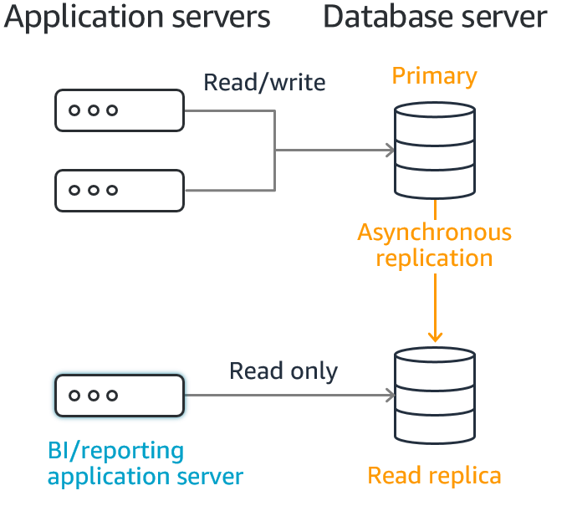
RDS Read Replica

Slide 78
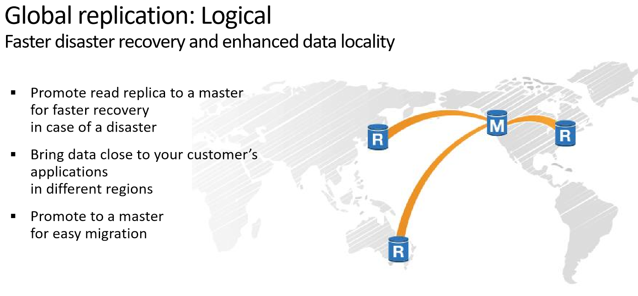

Slide 79
RDS Backup & Restore
Automatic Backups:
Restore your database to a point in time.
Are enabled by default.
Let you choose a retention period up to 35 days.
Manual Snapshots:
Let you build a new database instance from a snapshot.
Are initiated by the user.
Persist until the user deletes them.
Are stored in Amazon managed S3.
Restore Process:
You can restore till current time minus ten minutes (which uses Automatic backups).
New endpoint gets created for the restored DB.

Slide 80

RDS Optimizes Developer Productivity
Let developers focus on innovation:
Query construction
Query optimization
Offload the operational burdens:
Migration
Backup and recovery
Patching
Software upgrades
Storage upgrades
Frequent server upgrades
Hardware crash

Slide 81
RDS Pricing
You have both the models available:
On-demand pricing
Reserved pricing

Slide 82
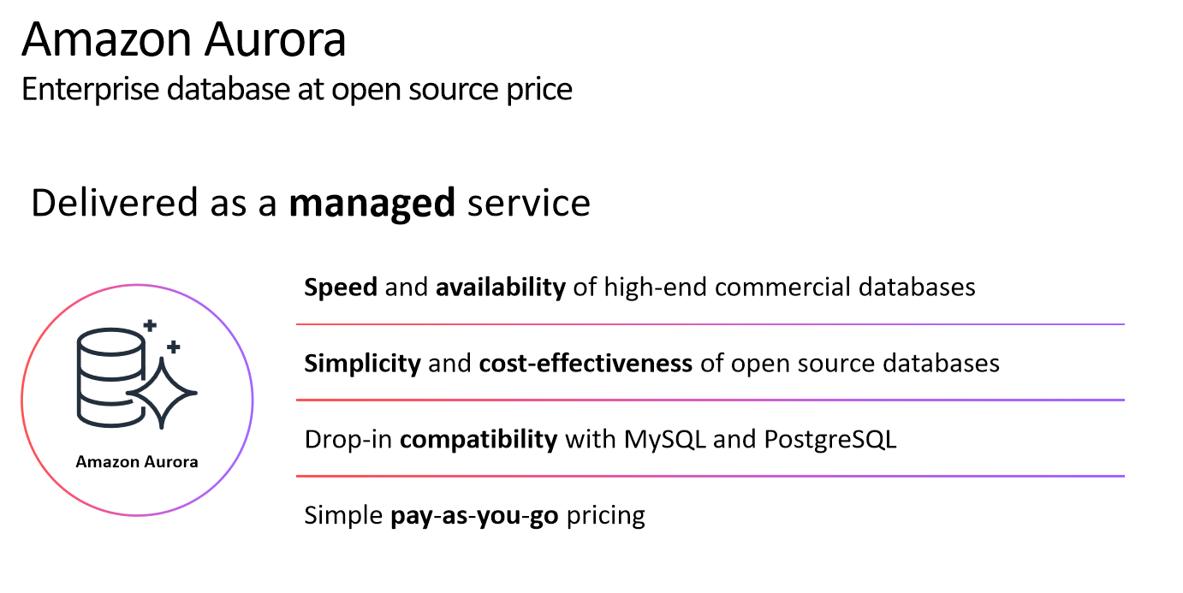

Slide 83
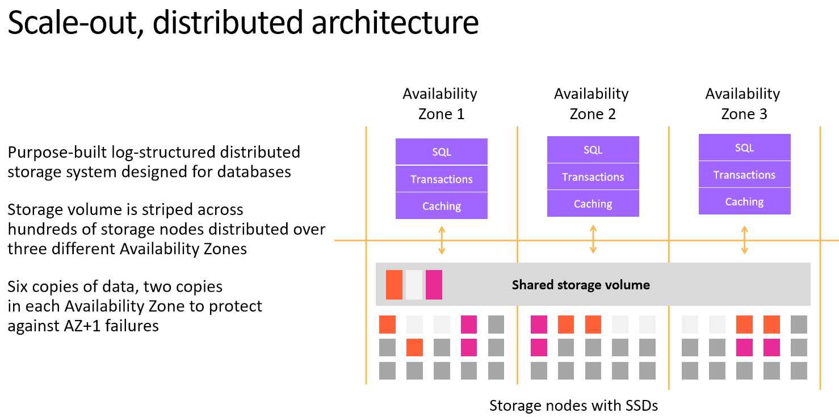

Slide 84
Amazon ElastiCache
Caches are in-memory databases with high performance, low latency. Helps reduce load off databases for read intensive workloads
Fully-managed in-memory data store (caching service, to boost DB read performance). AWS takes care of OS maintenance / patching, optimizations, setup, configuration, monitoring, failure recovery and backups
It is a remote caching service, or a side cache i.e. separate dedicated caching instance
Two flavors (both are open-source key-value stores)
Amazon ElastiCache for Redis
Amazon ElastiCache for Memcached
Sub-millisecond latency for real-time applications
The application logic needs to implement the storage and retrieval of data from the cache

Slide 85
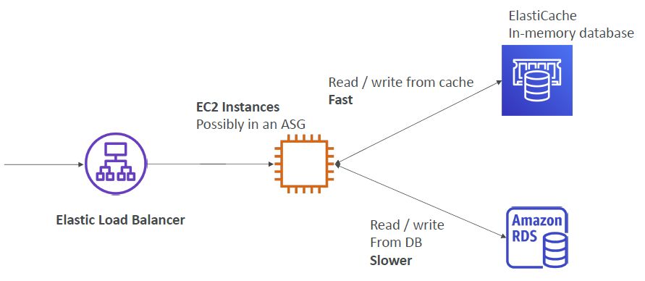
Amazon ElastiCache Example

Slide 86
DynamoDB
Allows you to store any amount of data with no limits.
Provides fast, predictable performance using SSDs.
Allows you to easily provision and change the request capacity needed for each table.
Is a fully managed, NoSQL database service.
No throughput limits.
Single-digit milliseconds latency.
Regional resource with data stored in multiple AZs.

Slide 87
DynamoDB Data Model
Artist
Song Title
Album Title
Year
Genre
Table: Music
Items
Attributes (name-value pairs)

Slide 88
Primary Keys
Artist
Song Title
Album Title
Year
Genre
Table: Music
Table: Music
Partition Key: Artist
Sort Key: Song Title
Partition Key
Sort Key
(DynamoDB maintains a sorted index for both keys)
You should choose a Partition Key that avoids Hot Partitions.

Slide 89
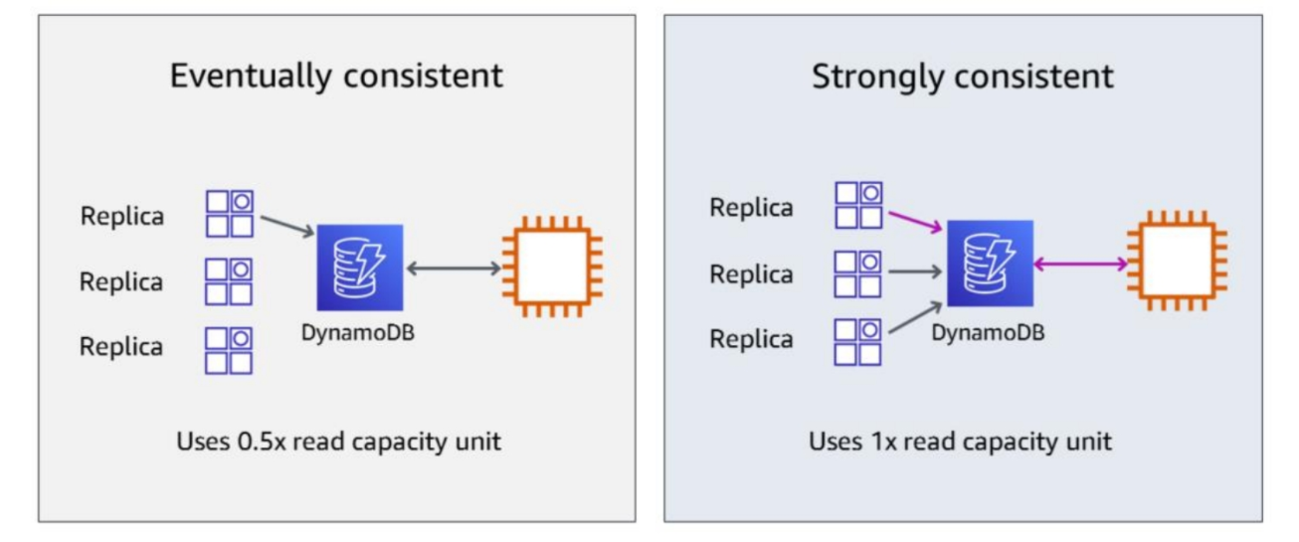
Consistency Options
Read Consistency: strong consistency, eventual consistency, and transactional
Write Consistency: standard and transactional
Strong Consistency
The most up-to-date data
Must be requested explicitly
Eventual Consistency
May or may not reflect the latest copy of data
Default consistency for all operations
50% cheaper than strong consistency
Transactional Reads and Writes
For ACID support across one or more tables within a single AWS account and region
2x the cost of strongly consistent reads
2x the cost of standard writes

Slide 90
DynamoDB Throughput
Provisioned capacity mode
With provisioned capacity mode, you specify the number of reads and writes per second that you expect your application to require. You can use auto scaling to automatically adjust your table’s capacity based on the specified utilization rate to ensure application performance while reducing costs.
On-demand capacity mode
With on-demand capacity mode, DynamoDB charges you for the data reads and writes your application performs on your tables. You do not need to specify how much read and write throughput you expect your application to perform because DynamoDB instantly accommodates your workloads as they ramp up or down.

Slide 91
Connectivity of different Databases on AWS
EC2
EC2
DynamoDB
Inside and outside of VPC
RDS
Aurora
ElastiCache
VPC
Region

Slide 92
Lab 3
Time allocated: 40 mins
Launch a Multi-AZ RDS (PostgreSQL) instance in private subnets of your VPC. (type – db.t3.micro, Storage – GP SSD – 30GB)
Once it is ready, connect it via the Public EC2 instance you had launched earlier.
Follow the instructions and use psql to access the RDS database.
Create a table and insert data into it.
Use python code on your EC2 instance to access the data RDS table.
Check the private IP of the RDS instance serving you. Make a note of it.
You can use “ping –a <<RDS endpoint>>”
Now, reboot your RDS with failover option and check the private IP of the RDS instance serving you. Make a note of this IP as well.
Verify these in the ENI section (under EC2 Dashboard).

Slide 93
Storage Services
Overview of S3, EBS, EFS
Pricing of S3 (different storage classes), EBS, EFS
Right use-cases for S3, EBS, EFS
AZ a
AZ b
AZ c

Slide 94
Storage Services
S3
Object based storage
Gives 11 9s of reliability
Uses global namespace
S3 bucket is a regional resource.
You interact via AWS APIs
WORM usage
EBS
Block based storage (disk)
Used with EC2
Read / write via OS level operation
It is located in an AZ
OS & DB usage
EFS
It can be mounted to multiple EC2 instances
Spans across AZs in a region
Read/write possible from multiple instances
Works only with Linux

Slide 95
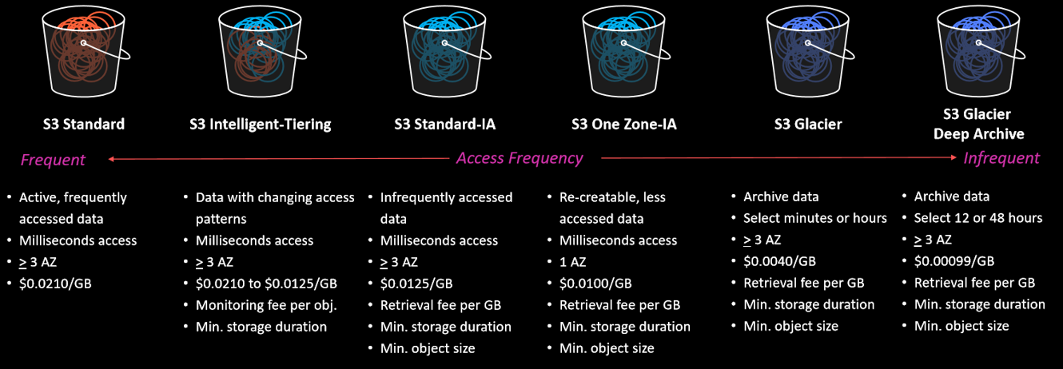
S3 Storage Classes
Pricing Factors:
Amount of Storage
Data transfer (out to internet)
Number of requests (GET, PUT, DELETE, etc.)

Slide 96
Lab 4
Time allocated: 30 mins
Activate CloudShell
Execute “aws configure” & “aws sts get-caller-identity”
Create new buckets and execute the following commands using AWS CLI https://docs.aws.amazon.com/cli/latest/reference/s3/
Setup Static website using S3.
Delete all the S3 buckets at the end.
CLI Command to empty a bucket: aws s3 rm s3://bucket001 --recursive

Slide 97
Load Balancer
A load balancer distributes incoming application traffic across multiple targets, such as EC2 instances, in multiple Availability Zones to increase the availability of your application.
Load Balancer
Listener
Listener
Rule
Rule
Rule
Target
Target
Target
Target
Target
Target
Target
(example.com)
(example.com/inventory)
(example.com/crm)
Target Groups

Slide 98
Load Balancer features
Automatically distributes traffic across multiple targets
Provides high availability
Incorporates security features
Performs health checks

Slide 99
Load Balancer types
Application Load Balancer (HTTP and HTTPS)
Flexible application management
Advanced load balancing of traffic
Operates at the request level (Layer 7)
Network Load Balancer (TCP & UDP)
Extreme performance and static IP
Load balancing of TCP traffic
Operates at the connection level (Layer 4)

Slide 100
Group Activity 1
Time allocated: 25 mins discussion & 10 mins presentation
A company has acquired another small company “myCRM”. They provide a hosted CRM tool to end users. Customers access the web application to:
View and log customer contact information – maintaining a record of all customer information viewable on all platforms
Upload and access customer contract documents from anywhere – capable through browser and mobile apps
Track status of customer forms as they proceed through the sales process – view the workflow and provide feedback on next steps or delivery expectations.
Users (consumers) connect to the myCRM application using their user ID and password (stored in the application database). Active Directory authenticates myCRM employees who need to access the system (e.g., engineers and customer support personnel). AD is present on-prem and is currently not moving to Cloud.
They are determined to host this application at AWS as soon as possible to get a better infrastructure.
Present a detailed architecture for this application on AWS. Please make notes on your design decisions. At this time, there is no plan to do any code change. It should be possible to move the application with minimal changes.

Slide 101
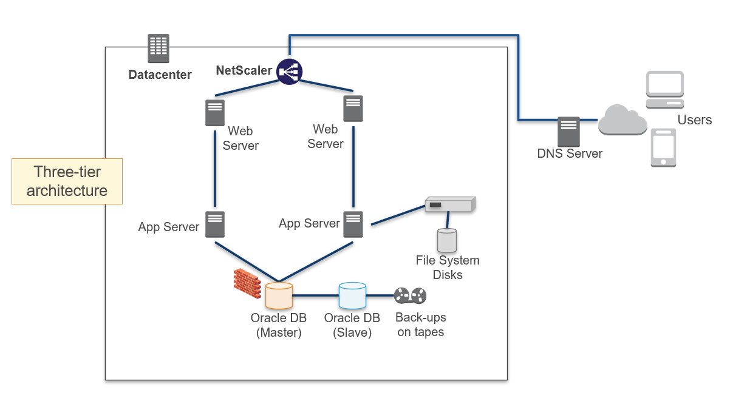
Group Activity 1

Slide 102
Route53
Route53 is a Managed DNS (Domain Name System)
DNS is a collection of rules and records which helps clients understand how to reach a server through URLs.
In AWS, the most common records are:
A: hostname to IPv4
AAAA: hostname to IPv6
CNAME: hostname to hostname
Alias: hostname to AWS resource.

Slide 103
Route53 Routing Policies
Simple
Weighted
Latency
Failover
Geolocation

Slide 104
Monitoring
CloudWatch Metrics
CloudWatch Events
CloudWatch Logs
Use of CloudWatch with other AWS services and on-premises

Slide 105
AWS CloudWatch Metrics
• CloudWatch provides metrics for every services in AWS
• Metric is a variable to monitor (CPUUtilization, NetworkIn, etc.)
• Metrics belong to namespaces
• Dimension is an attribute of a metric (instance id, environment, etc.)
• Metrics have timestamps
• Can create CloudWatch dashboards of metrics
• Integrated with most of the AWS services
• EC2 Standard & Detailed Monitoring
• Standard & Custom Metrics

Slide 106
CloudWatch Dashboards
• Great way to setup custom dashboards for quick access to key metrics and alarms
• Dashboards are global
• Dashboards can include graphs from different AWS accounts and regions
• You can change the time zone & time range of the dashboards
• You can setup automatic refresh (10s, 1m, 2m, 5m, 15m)
• Dashboards can be shared with people who don’t have an AWS account (public, email address, 3rd party SSO provider through Amazon Cognito)

Slide 107
CloudWatch Logs
• Applications can send logs to CloudWatch using the AWS SDK
• CloudWatch can collect log from:
• Elastic Beanstalk: collection of logs from application
• ECS: collection from containers
• AWS Lambda: collection from function logs
• VPC Flow Logs: VPC specific logs
• API Gateway
• CloudTrail based on filter
• CloudWatch log agents: for example on EC2 machines
• Route53: Log DNS queries

Slide 108
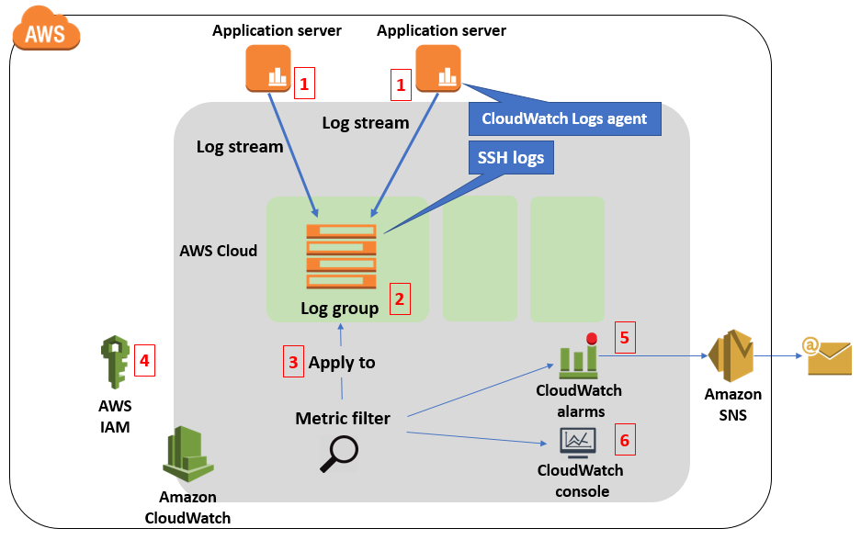
CloudWatch Logs

Slide 109
CloudWatch Events
Event Pattern: Intercept events from AWS services (Sources)
• Example sources: EC2 Instance Start, CodeBuild Failure, S3, Trusted Advisor
• Can intercept any API call with CloudTrail integration
Schedule or Cron (example: create an event every 4 hours)
A JSON payload is created from the event and passed to a target
• Compute: Lambda, Batch, ECS task
• Integration: SQS, SNS, Kinesis Data Streams, Kinesis Data Firehose
• Orchestration: Step Functions, CodePipeline, CodeBuild
• Maintenance: SSM, EC2 Actions

Slide 110
AWS CloudTrail
• Provides governance, compliance and audit for your AWS Account
• CloudTrail is enabled by default!
• Get an history of events / API calls made within your AWS Account by:
• Console
• SDK
• CLI
• AWS Services
• Can put logs from CloudTrail into CloudWatch Logs or S3
• A trail can be applied to All Regions (default) or a single Region.
• If a resource is deleted in AWS, investigate CloudTrail first!

Slide 111
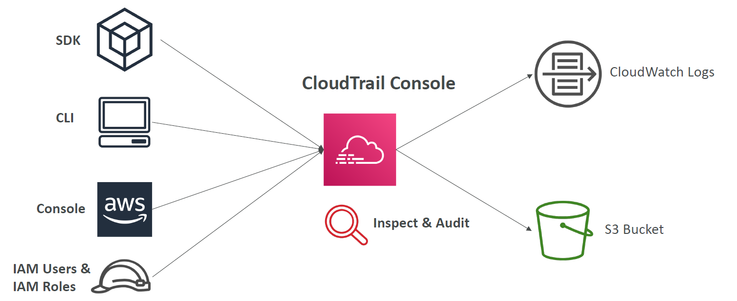
AWS CloudTrail – Information Flow

Slide 112
EC2 Auto Scaling
Amazon EC2 Auto Scaling helps you ensure that you have the correct number of EC2 instances available to handle the load for your application.
It could be a constant number of instances running all the time.
It could be a scale-out and scale-in requirement as well.
Launch configuration and launch templates
Amazon EC2 Auto Scaling group
Auto scaling policy
What resources do you need?
Where and how many do you need?
When and for how long do you need them?

Slide 113
EC2 Auto Scaling – Policy types
Scheduled – scaling happens on a scheduled time
Dynamic – scaling happens based on a defined condition/metric value
Predictive – scaling happens based on past load patterns

Slide 114
How to use Auto Scaling feature?
Your application should be stateless to get full benefits of Auto scaling feature.
Session information should be stored in an external storage (e.g. ElastiCache, DynamoDB, etc.)
Session stickiness should not be a requirement.
Load Balancer
Listener
Listener
Rule
Rule
Rule
Target
Target
Target
Target
Target
Target
Target
(example.com)
(example.com/blog)
(example.com/mobile)
Target Groups

Slide 115
Lab 5
Time allocated: 60 mins
Create a launch template with the specified AMI
Create an Auto Scaling group & Load Balancer
Test your application
Test high availability of your application tier by terminating an instance
Load the application and verify scale-out and scale-in

Slide 116
Availability concepts
High availability minimizes downtime and cost. It protects against failure. It keeps your business running with very little downtime and fast recovery, at low cost.
Fault tolerance is often confused with high availability, but fault tolerance refers to the built-in redundancy of an application's components to ensure that there is no service interruption, but at a higher cost.
Backup is critical to protect data and to ensure business continuity. At the same time, it can be a challenge to implement well. The pace at which data is generated is growing exponentially.
Disaster recovery is often overlooked as a component of availability. If a natural disaster makes one or more of your components unavailable or destroys your primary data source, can you restore service quickly and without lost data?
RTO – How long can the application be unavailable?
RPO – How often does data need to be backed up?

Slide 117
DR Strategies
Backup & restore - take backups off current systems and store them in Amazon S3. Know which AMI to use or build your own as needed. Know how to restore systems from backups, how to switch to a new system, and how to configure the deployment. When reacting to a disaster, retrieve backups from Amazon S3 and bring up your required infrastructure. Use CloudFormation to automate deployment of core networking. Next, restore system from backup, switch over to the new system, and adjust DNS records to point to AWS.
Pilot light – in this approach, you replicate your data from one Region to another and provision a copy of your core workload infrastructure. Resources required to support data replication and backup, such as databases and object storage, are always on. The pilot light architecture is relatively inexpensive to implement.
Fully working low-capacity standby - is an elevated version of the pilot light. The warm standby approach involves ensuring that there is a scaled down, but fully functional, copy of your production environment in another Region. This approach extends the pilot light concept and decreases the time to recovery because your workload is always on in another Region.
Multi-site active-active – this approach will have full infrastructure in your DR region as well as on your existing region. The data replication method that you employ will be determined by the recovery point that you choose. This architecture potentially has the least downtime of all.

Slide 118
DR Strategies - comparison
Backup and restore
Pilot light
Warm standby in AWS
Hot multi-site standby
Low
High
RPO-RTO: Hours
RPO-RTO: 10s of minutes
RPO-RTO: minutes
RPO-RTO: Real-time
Lowest priority use cases
Solutions: Amazon S3, Storage Gateway
Lower RTO and RPO requirements
Core services
Scale AWS resources in response to a DR event
Higher priority solutions require RTO and RPO in minutes
Business-critical services
Highest priority
Auto-failover of your environment in AWS to a running duplicate
$
$$
$$$
$$$$

Slide 119
Group Activity 2
Time allocated: 60 mins discussion & 15 mins presentation
Your client has recently experienced tremendous sales growth and must support significant amounts of new users.
This means:
Significant increase in users simultaneously accessing the system.
Increased number of customer interactions to manage.
Increased contracts to create and track.
Increased storage needs.
Due to this volume increase, you have been requested to redesign an entire solution. The CTO has given you the following requirements:
1. Reliability
Deployment is required in 2 regions: US East Coast and Southeast Asia (only one site active at a time)
Must be able to remain fully functional during any component failure
2. Security
User authentication for web browser clients (will be based on app, uses credentials stored in app DB)
Minimal exposure for any items in the public subnet
Security for Data at Rest and Data in Transit

Slide 120
Group Activity 2
3. Performance Efficiency
Three-tier architecture with Web, App, and DB tiers
Web and App tiers should be loosely coupled and scalable
Web-tier should be stateless
DB tier runs relational database
Session information should be durably stored in a fault tolerant way
Must scale to handle the increasing workload
Solution should be designed to deliver greatest performance for the end user
4. Cost Minimization
Make architectural decisions which have justifiable costs.
Cost Optimization includes both tangible and intangible costs
NOTE: It is a complete re-architecting so you can adopt all the best practices & recommendations, but you should back your choices against the requirements given.

Slide 121
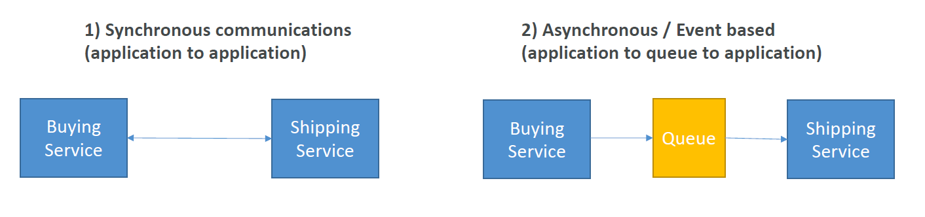
Decoupled Systems
When we start deploying multiple applications, they will inevitably need to communicate with one another
There are two patterns of application communication

Slide 122
Simple Queue Service (SQS)
Fully managed service, used to decouple applications
Unlimited throughput, unlimited number of messages in queue
Default retention of messages: 4 days, maximum of 14 days
Low latency (<10ms on publish and receive)
Limitation of 256KB per message sent
Can have duplicate messages (at least once delivery, occasionally)
Can have out of order messages (best effort ordering)

Slide 123
SQS – Producing Messages
Produced to SQS using the AWS SDK
The message is persisted in SQS until a consumer deletes it
Message retention: default 4 days, up to 14 days
Example: send an order to be processed
Order id
Customer id
Any attributes you want
SQS standard: unlimited throughput

Slide 124
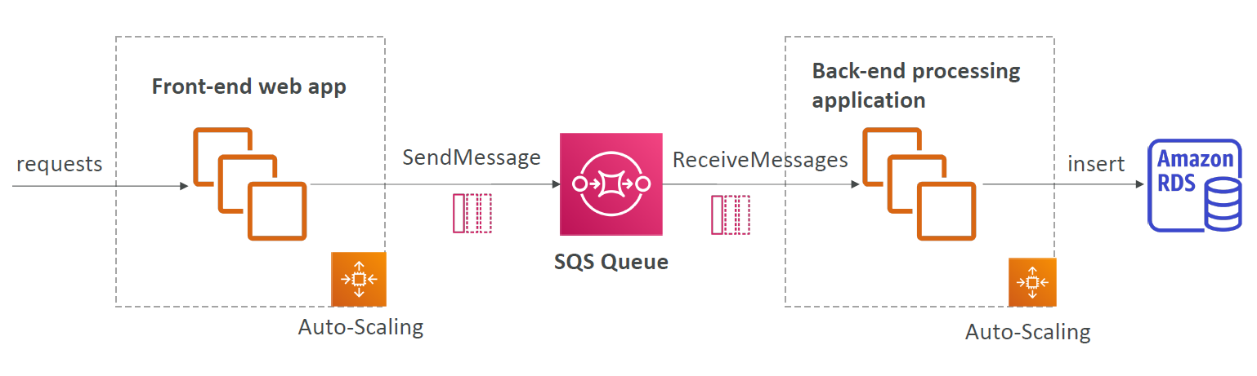
SQS – Consuming Messages
Consumers (running on EC2 instances, servers, or AWS Lambda)…
Poll SQS for messages (receive up to 10 messages at a time)
Process the messages (example: insert the message into an RDS database)
Delete the messages using the AWS API

Slide 125
SQS – Security
Encryption:
In-flight encryption using HTTPS API
At-rest encryption using KMS keys
Client-side encryption if the client wants to perform encryption/decryption itself
Access Controls: IAM policies to regulate access to the SQS API
SQS Access Policies (similar to S3 bucket policies)
Useful for cross-account access to SQS queues
Useful for allowing other services (SNS, S3, etc.) to write to an SQS queue

Slide 126
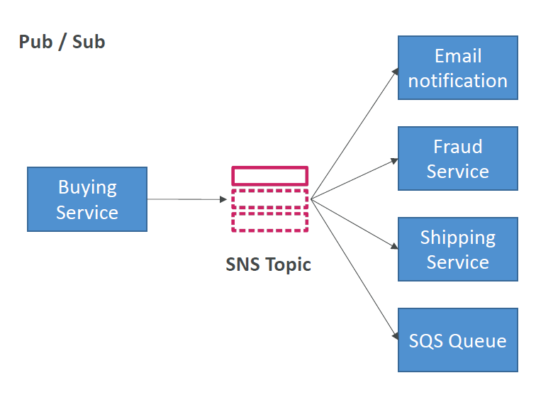
Simple Notification Service (SNS)
• The “event producer” only sends message to one SNS topic
• As many “event receivers” (subscriptions) as we want to listen to the SNS topic notifications
• Each subscriber to the topic will get all the messages
• Up to 10,000,000 subscriptions per topic
• 100,000 topics limit
• Subscribers can be:
• SQS
• HTTP / HTTPS
• Lambda
• Emails
• SMS messages
• Mobile Notifications

Slide 127
SNS Integration (examples)
• Many AWS services can send data directly to SNS for notifications
• CloudWatch (for alarms)
• Auto Scaling Groups notifications
• Amazon S3 (on bucket events)
• CloudFormation (upon state changes => failed to build, etc.)

Slide 128
SNS – How to publish
• Topic Publish (using the SDK)
• Create a topic
• Create a subscription (or many)
• Publish to the topic
• Direct Publish (for mobile apps SDK)
• Create a platform application
• Create a platform endpoint
• Publish to the platform endpoint

Slide 129
SNS - Security
Encryption:
• In-flight encryption using HTTPS API
• At-rest encryption using KMS keys
• Client-side encryption if the client wants to perform encryption/decryption itself
Access Controls: IAM policies to regulate access to the SNS API
SNS Access Policies (similar to S3 bucket policies)
• Useful for cross-account access to SNS topics
• Useful for allowing other services ( S3 etc.) to write to an SNS topic

Slide 130
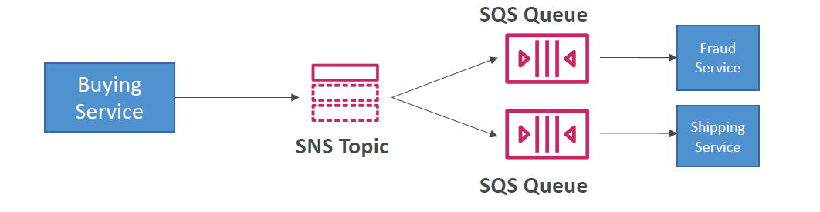
SNS + SQS (Fan Out)
• Push once in SNS, receive in all SQS queues that are subscribers
• Fully decoupled, no data loss
• SQS allows for: data persistence, delayed processing and retries of work
• Ability to add more SQS subscribers over time
• Make sure your SQS queue access policy allows for SNS to write

Slide 131
SERVERLESS

Slide 132
Serverless approach
Serverless is a new paradigm in which the developers don’t have to manage servers anymore
They just deploy code in the form of functions
Serverless does not mean there are no servers, it means you just don’t manage / provision / see them

Slide 133
AWS Lambda Overview
No servers to maintain - serverless
Supports code in many languages - C#, Java, Python, node.js, Go, etc.
Offers many levels of resources:
128 MB of memory and the lowest CPU power, to
10 GB of memory and the highest CPU power
A function can run up to 15 minutes when invoked
Pricing depends on
resource level chosen
actual time of execution (rounded off to nearest 1ms)
number of invocation requests
Saves money as compute is used only when required (no resources are blocked/running all the time)
Supports IAM role & VPC connectivity

Slide 134
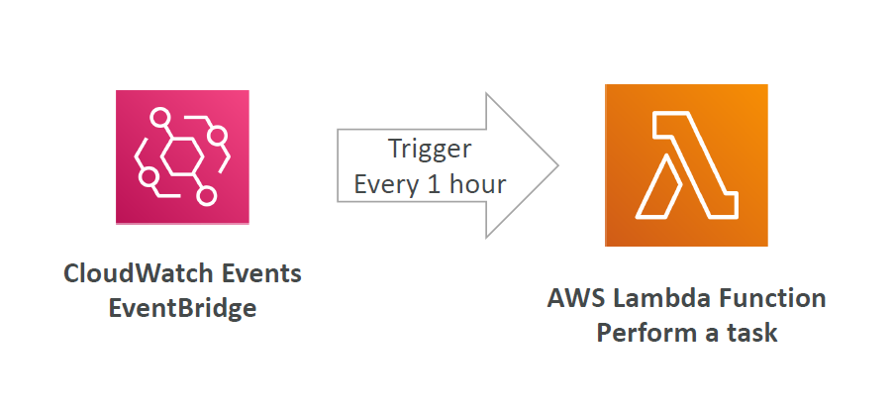
Example: Serverless CRON Job

Slide 135
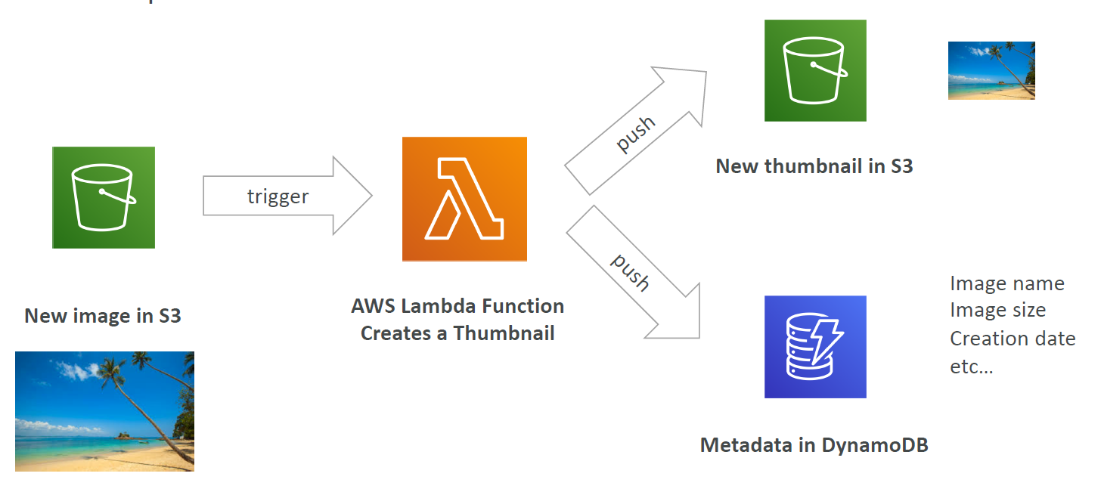
Example: Serverless Thumbnail creation

Slide 136
AWS Secrets Manager
• A service meant for storing secrets
• Capability to force rotation of secrets every X days
• Automate generation of secrets on rotation (uses Lambda – custom code to interact with the respective service)
• Integration with Amazon RDS (MySQL, PostgreSQL, Aurora)
• Secrets are encrypted using KMS
• Mostly meant for RDS integration

Slide 137
AWS Key Management Service (KMS)
AWS KMS makes it easy for you to create and manage cryptographic keys and control their use across a wide range of AWS services and in your applications.
AWS KMS is integrated with AWS CloudTrail to provide you with logs of all key usage to help meet your regulatory and compliance needs.
Three types of Customer Master Keys (CMK):
AWS Managed Service Default CMK: free
User Keys created in KMS: $1 / month
User Keys imported (must be 256-bit symmetric key): $1 / month

Slide 138
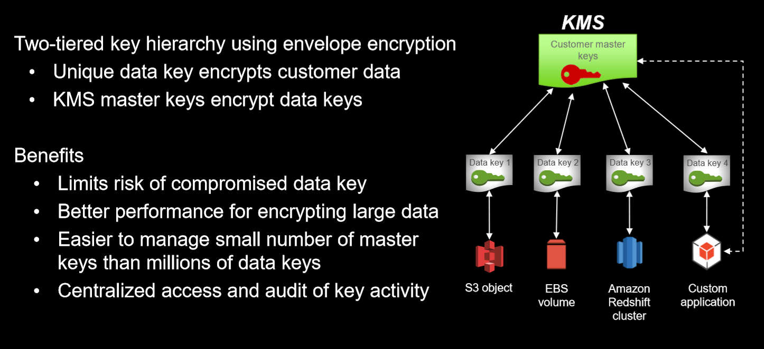
Client Integration with KMS

Slide 139
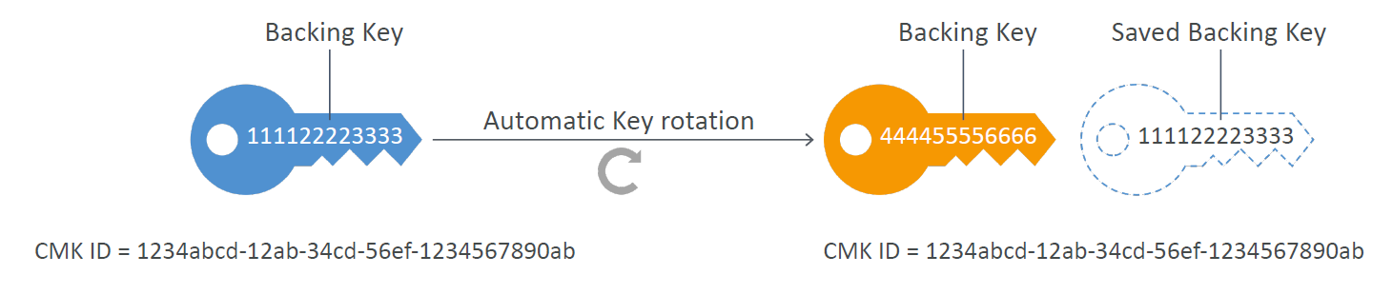
KMS Automatic Key Rotation
• For Customer-managed CMK (not AWS managed CMK)
• If enabled: automatic key rotation happens every 1 year
• Previous key is kept active so you can decrypt old data
• New Key has the same CMK ID (only the backing key is changed)

Slide 140
Infrastructure as Code

Slide 141
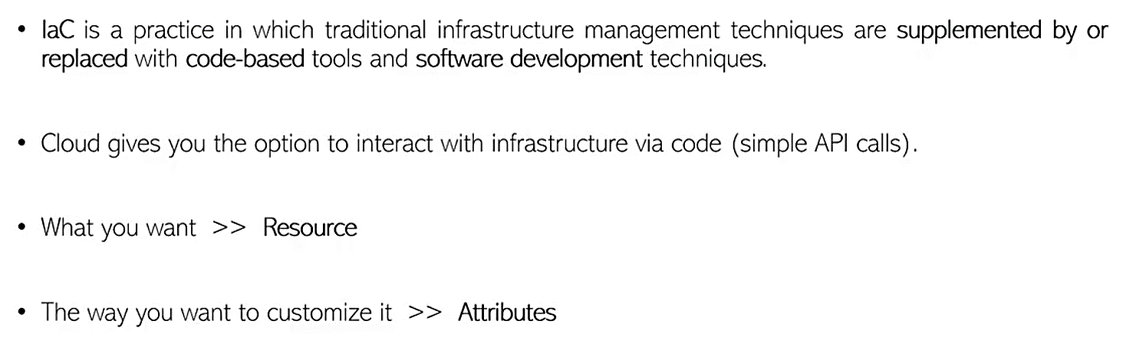
Infrastructure as Code

Slide 142
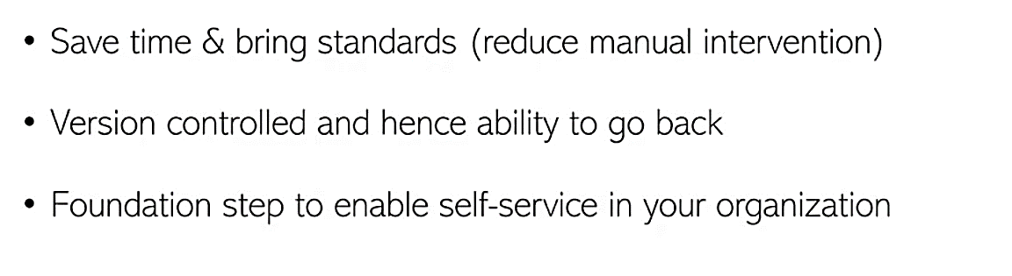
How could it help my Organization

Slide 143
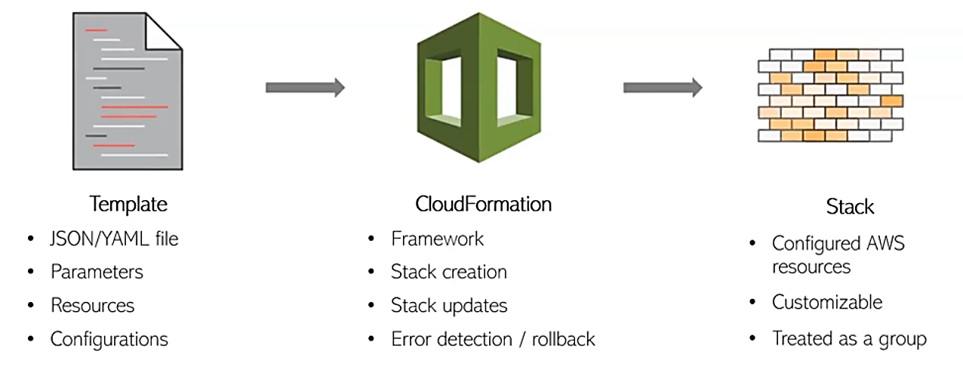
The Flow

Slide 144
Lab 6
Time allocated: 40 mins
AWS resource deployment using Terraform Code.
Configure terraform in the Public EC2 instance and execute the steps.
Verify the created resources in AWS Management Console.

Slide 145
Feedback
I hope you learned from this course and I was able to answer your questions. Please fill the course evaluation below, it takes only 5 minutes ☺
Open this URL – https://www.surveymonkey.com/r/WJ3TRVH
Please type DONE in chat after completing this.

